Slide 1

Exploring dropouts and Transfer Learning with Inception
Notes:
1

Slide 2
Objectives
Understand the dropout
Create new model by using a pre-trained model to achieve good results even with a small training dataset
Exploring dropouts and Transfer Learning with Inception
2

Slide 3
The dropout
It is to remove a random number of neurons in your neural network.
This works very well for two reasons:
The first is that neighboring neurons often end up with similar weights, which can lead to overfitting, so dropping some out at random can remove this.
The second is that often a neuron can over-weigh the input from a neuron in the previous layer, and can over specialize as a result.
Exploring dropouts and Transfer Learning with Inception
3

Slide 4
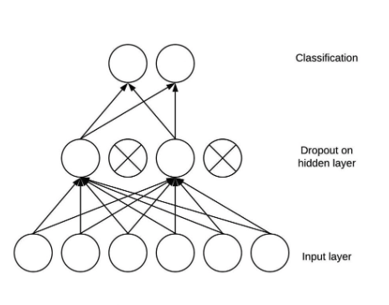
The dropout
Exploring dropouts and Transfer Learning with Inception
4

Slide 5
Setup the pre-trained model
You will need to prepare pre-trained model and configure the layers that you need. For this session, you will use the convolution layers of the InceptionV3 architecture as your base model. To do that, you need to:
Set the input shape to fit your application. In this case, set it to 150x150x3 as you've been doing in the last few labs.
Pick and freeze the convolution layers to take advantage of the features it has learned already.
Add dense layers which you will train.
Exploring dropouts and Transfer Learning with Inception
5
Notes:
5

Slide 6
InceptionV3
Convolutional neural network (CNN) architecture designed for image classification and object detection.
It is part of the Inception family of models developed by Google, with the goal of improving computational efficiency while maintaining or even enhancing performance.
InceptionV3 employs a module called an "Inception module" that uses various filter sizes (1x1, 3x3, and 5x5 convolutions) in parallel to capture features at different scales.
It incorporates batch normalization and factorized convolutions to reduce the computational cost.
Exploring dropouts and Transfer Learning with Inception
6
Notes:
6

Slide 7
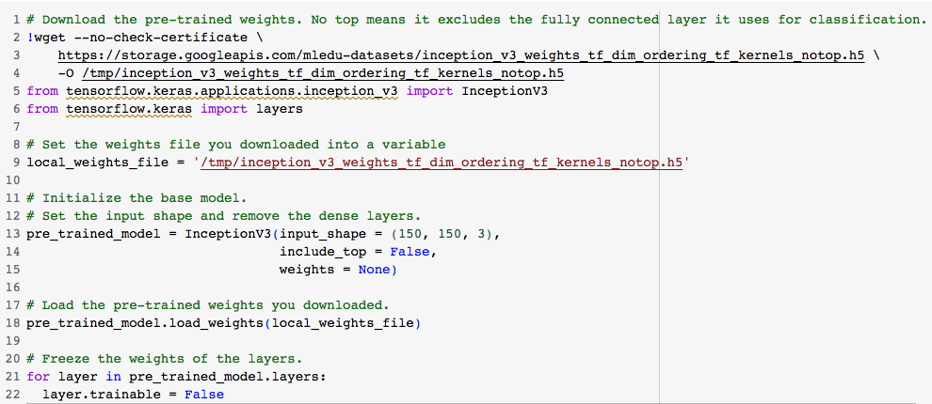
Download the pre-trained weights
What
Exploring dropouts and Transfer Learning with Inception
7
Notes:
7

Slide 8

Select last layer
What
Exploring dropouts and Transfer Learning with Inception
8
Notes:
8

Slide 9
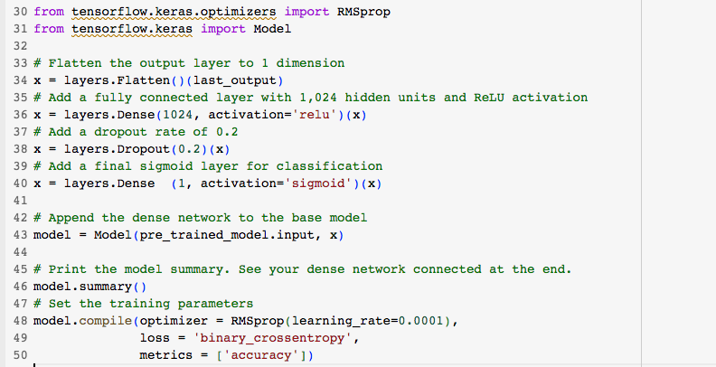
Add dense layers for your classifier
What
Exploring dropouts and Transfer Learning with Inception
9
Notes:
9

Slide 10
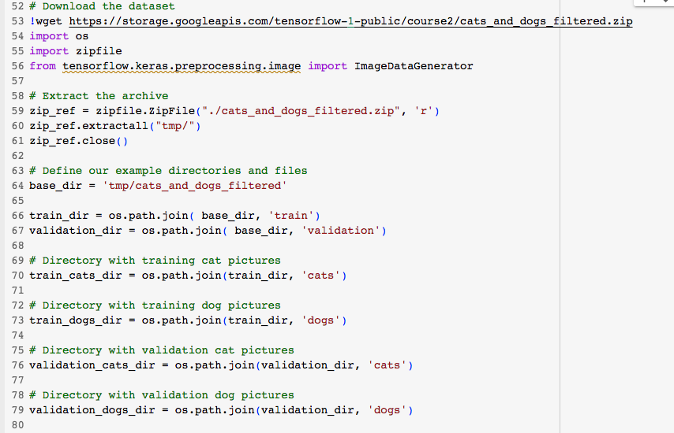
Prepare the dataset
What
Exploring dropouts and Transfer Learning with Inception
10
Notes:
10

Slide 11
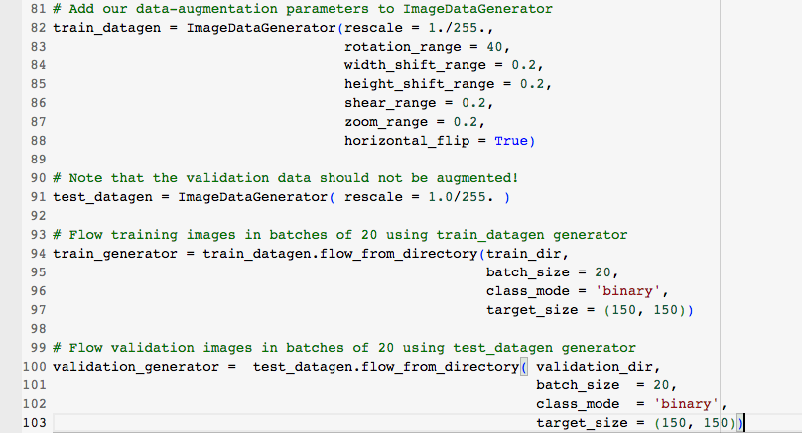
Prepare the dataset
What
Exploring dropouts and Transfer Learning with Inception
11
Notes:
11

Slide 12
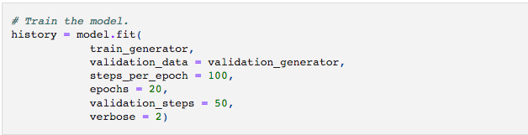
Train the model
What
Exploring dropouts and Transfer Learning with Inception
12
Notes:
12

Slide 13
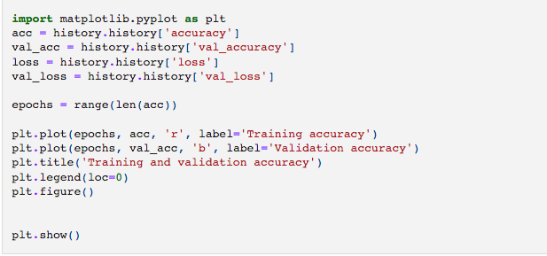
Evaluate the results
What
Exploring dropouts and Transfer Learning with Inception
13
Notes:
13

Slide 14
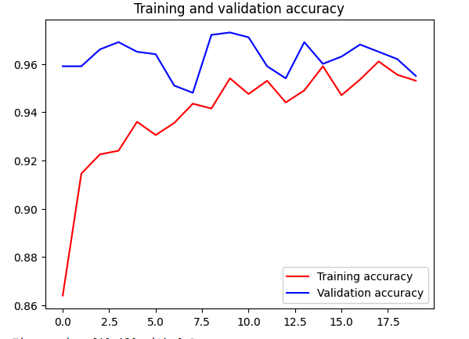


Evaluate the results
Exploring dropouts and Transfer Learning with Inception
14
Notes:
14

Slide 15
Summary
Understand the dropout
Create new model by using a pre-trained model to achieve good results even with a small training dataset
Exploring dropouts and Transfer Learning with Inception
15

Slide 16
Q & A
Exploring dropouts and Transfer Learning with Inception
16

